Slide 1
COMPILER CONSTRUCTION

Slide 2
COURSE OUTCOMES
1 Compare different language Processors and design Lexical Analyzer for a given language.
2 Design Parser using top down and bottom up parsing techniques
3 Generate Intermediate code for a given set of instructions
4 Choose a data structures for symbol table organization and dynamic memory management
5 Apply various code optimization techniques to generate efficient target code

Slide 3
UNIT-I
Introduction: Language Processors, The structure of the compiler,
The science of building compiler.
Lexical analysis: The role of Lexical Analyzer, Input Buffering,
Specification of Tokens. Recognition of Tokens, The Lexical-Analyzer
Generator LEX.
UNIT-II
Syntax Analysis: Introduction, Context free grammars, Writing a
grammar, Top-Down parsing- Bottom-Up parsing, More powerful LR
parsers, Using ambiguous grammars, Parser Generators .
UNIT-III
Syntax Directed Translation: Syntax Directed Definitions,
Evaluation Orders for SDDs, Applications of Syntax Directed
Translation.
Intermediate code generation: Introduction, Variants of syntax
trees, Three-Address Code, Types and Declarations, Translation of
Expressions, Type Checking. Control Flow.
UNIT-IV
Run-time Environments: Storage Organization, Stack Allocation of Space, Access to Non local Data on the Stack. Heap Management, Introduction to Garbage Collection
Symbol Table Organization: Structure of Symbol table, Symbol
Table organization for Block Structured and non block Structure
languages, Data Structures of symbol Table.
UNIT-V
Code Generation: Issues in the Design of a Code Generator, The
Target Language, Addresses in the Target Code Basic Blocks and Flow Graphs.
Code Optimization: Optimization of Basic Blocks. Peephole
Optimization, Register Allocation and Assignment, Machine
Independent Optimizations – The Principal Sources of Optimizations, Introduction to data flow analysis.

Slide 4
TEXT BOOK
Alfred V Aho, Monica S Lam, Ravi Sethi, Jeffrey D Ullman,Compilers: Principles, Techniques & Tools, 2nd Edition(2022), Pearson Education.

Slide 5
UNIT-II
Syntax Analysis:
Introduction,
Context free grammars,
Writing a grammar,
Top-Down parsing
Bottom-Up parsing,
More powerful LR parsers,
Using ambiguous grammars,
Parser Generators .

Slide 6
THE ROLE OF THE PARSER
Read Character Token
input
Lexical
Analyzer
Parser
Push back
character
Get Next Token
Symbol
Table

Slide 7
Where is Syntax Analysis?
if (idx == 0) idx = 750;
Lexical Analysis or Scanner
if
(
idx
==
0
)
idx
=
750
;
Syntax Analysis or Parsing
if
Abstract syntax tree
or parse tree
= =
=
idx
0
idx
750

Slide 8
Introduction to Parsers
source
code
token
Scanner
Parser
syntax
Semantic Analyzer
tree
next token
Symbol
Table

Slide 9
Syntax Trees
A syntax tree represents the syntactic structure of tokens in a program defined by the grammar of the programming language
:=
id₁
+
id₂
*
id₃
60

Slide 10
SYNTAX ANALYSIS
Syntax analysis is the second phase of the compiler. It gets the input from the
tokens and generates a syntax tree or parse tree. Advantages of grammar for
syntactic specification
1. A grammar gives a precise and easy-to-understand syntactic specification of a programming language.
2. An efficient parser can be constructed automatically from a properly designed grammar.
3. A grammar imparts a structure to a source program that is useful for its translation into object code and for the detection of errors.
4. New constructs can be added to a language more easily when there is a grammatical description of the language.

Slide 11
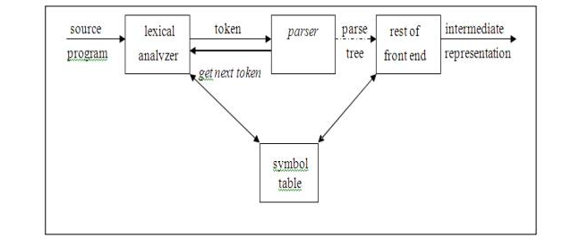
THE ROLE OF PARSER
The parser or syntactic analyzer obtains a string of tokens from the lexical
analyzer and verifies that the string can be generated by the grammar for the
source language. It reports any syntax errors in the program. It also recovers
from commonly occurring errors so that it can continue processing its input.

Slide 12
Syntax error handling
Programs can contain errors at many different levels. For example
1. Lexical, such as misspelling an identifier, keyword or operator.
2. Syntactic, such as an arithmetic expression with unbalanced parentheses.
3. Semantic, such as an operator applied to an incompatible operand.
4. Logical, such as an infinitely recursive call.
Functions of error handler
1. It should report the presence of errors clearly and accurately.
2. It should recover from each error quickly enough to be able to detect
subsequent errors.
3. It should not significantly slow down the processing of correct programs.

Slide 13
Error recovery strategies
The different strategies that a parse uses to recover from a syntactic error are
1. Panic mode
2. Phrase level
3. Error productions
4. Global correction
Panic mode recovery
On discovering an error, the parser discards input symbols one at a time until a
synchronizing token is found. The synchronizing tokens are usually delimiters,
such as semicolon or end. It has the advantage of simplicity and does not go
into an infinite loop. When multiple errors in the same statement are rare, this
method is quite useful.

Slide 14
Phrase level recovery
On discovering an error, the parser performs local correction on the remaining
input that allows it to continue. Example: Insert a missing semicolon or delete
an extraneous semicolon etc.
Error productions
The parser is constructed using augmented grammar with error productions. If
an error production is used by the parser, appropriate error diagnostics can be
generated to indicate the erroneous constructs recognized by the input.
Global correction
Given an incorrect input string x and grammar G, certain algorithms can be
used to find a parse tree for a string y, such that the number of insertions,
deletions and changes of tokens is as small as possible. However, these
methods are in general too costly in terms of time and space.

Slide 15
Parser can not detect errors and these issues are handled by Semantic Analysis phase.
1. Variable re-declaration
2. Variable initialization before use
3. Data type mismatch for an operation.
Why Parsers Can’t Detect It:
Parsers focus on grammar rules and syntax trees.
Variable initialization is a semantic constraint that requires analyzing the control flow to ensure proper order of variable usage.
Variable re-declaration is a semantic issue related to the symbol table (which tracks variable names and their properties).
Semantic analysis, performed after parsing, handles such issues by checking the symbol table for duplicate declarations, type checking, and scope rules.

Slide 16
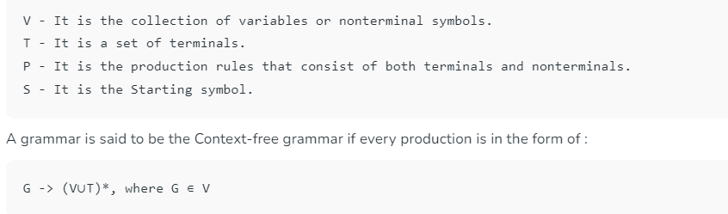
Context-Free Grammars (CFG)
Context Free Grammar is formal grammar, the syntax or structure of a formal language can be described using context-free grammar (CFG), a type of formal grammar. The grammar has four tuples: (V,T,P,S).

Slide 17
An Example: Arithmetic Expressions
Terminals: id, ‘+’, ‘-’, ‘*’, ‘/’, ‘(’, ‘)’
Nonterminals: expr, op
Productions:
expr → expr op expr
expr → ‘(’ expr ‘)’
expr → ‘-’ expr
expr → id
op → ‘+’ | ‘-’ | ‘*’ | ‘/’
Start symbol: expr

Slide 18
An Example: Arithmetic Expressions
id ⇒ { id },
‘+’ ⇒ { + },
‘-’ ⇒ { - },
‘*’ ⇒ { * },
‘/’ ⇒ { / },
‘(’ ⇒ { ( },
‘)’ ⇒ { ) },
op ⇒ { +, -, *, / },
expr ⇒ { id, - id, ( id ), id + id, id - id, … }.

Slide 19
Derivations
A derivation step is an application of a production as a rewriting rule, namely, replacing a nonterminal in the string by one of its right-hand sides, N → α
… N … ⇒ … α …
Starting with the start symbol, a sequence of derivation steps is called a derivation
S ⇒ … ⇒ α
or S ⇒* α

Slide 20
An Example
Grammar:
expr → expr op expr
expr → ‘(’ expr ‘)’
expr → ‘-’ expr
expr → id
5. op → ‘+’
6. op → ‘-’
7. op → ‘*’
8. op → ‘/’
Derivation:
expr
⇒ - expr
⇒ - (expr )
⇒ - (expr op expr )
⇒ - ( id op expr )
⇒ - ( id + expr )
⇒ - ( id + id )

Slide 21
Left- & Right-Most Derivations
If there are more than one nonterminal in the string, many choices are possible
A leftmost derivation always chooses the leftmost nonterminal to rewrite
A rightmost derivation always chooses the rightmost nonterminal to rewrite

Slide 22
An Example
Leftmost derivation:
expr
⇒ - expr
⇒ - (expr )
⇒ - (expr op expr )
⇒ - (id op expr )
⇒ - ( id + expr )
⇒ - ( id + id )
Rightmost derivation:
expr
⇒ - expr
⇒ - (expr )
⇒ - (expr op expr )
⇒ - (expr op id)
⇒ - (expr + id )
⇒ - ( id + id )

Slide 23
Parse Trees
A parse tree is a graphical representation for a derivation that filters out the order of choosing non terminals for rewriting
Many derivations may correspond to the same parse tree, but every parse tree has associated with it a unique leftmost and a unique rightmost derivation

Slide 24
An Example
Leftmost derivation:
expr
⇒ - expr
⇒ - (expr )
⇒ - (expr op expr )
⇒ - (id op expr )
Rightmost derivation:
expr
⇒ - expr
⇒ - (expr )
⇒ - (expr op expr )
⇒ - (expr op id)
⇒ - (expr + id )
⇒ - ( id + expr )
⇒ - ( id + id )
⇒ - ( id + id )

Slide 25

A grammar is ambiguous if it can derive a string with two different parse trees
If we use the syntactic structure of a parse tree to interpret the meaning of the string, the two parse trees have different meanings
Since compilers do use parse trees to derive meaning, we would prefer to have unambiguous grammars

Slide 26
An Example
id + id * id
expr
expr
expr
+
expr
expr
*
expr
id
expr
*
expr
expr
+
expr
id
id
id
id
id

Slide 27

Ambiguous grammar:
expr → expr op expr
expr → ‘(’ expr ‘)’
expr → ‘-’ expr
expr → id
op → ‘+’ | ‘-’ | ‘*’ | ‘/’
Not every ambiguous grammar can be transformed to an unambiguous one!
Unambiguous grammar:
expr → expr ‘+’ term
expr → expr ‘-’ term
expr → term
term → term ‘*’ factor
term → term ‘/’ factor
term → factor
factor → ‘(’ expr ‘)’
factor → ‘-’ expr
factor → id

Slide 28
Push-Down Automata
Input
 |  |  |  |  |  | $
$
Finite Automata
Stack
Output

Slide 29
End-Of-File and Bottom-of-Stack Markers
Parsers must read not only terminal symbols but also the end-of-file marker and the bottom- of-stack maker
We will use $ to represent the end of file marker
We will also use $ to represent the bottom-of- stack maker

Slide 30
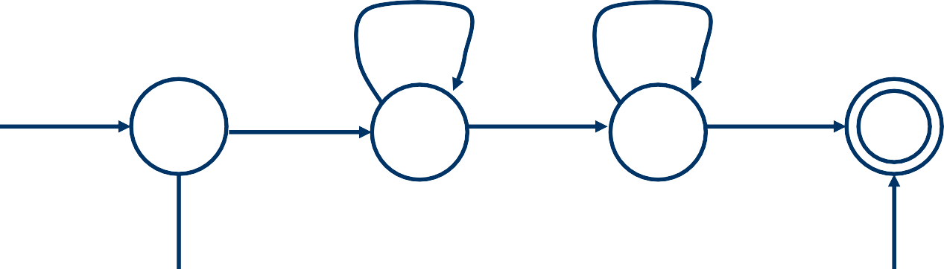
An Example
S → a S b
S → ε
(a, a) a↓
2
(b, a) a↑
3
start
(a, $)
a↓
(b, a) a↑ ($, $)
($, $)
1
4
1 → 2 → 2 → 3 → 3 → 4 a a b b $
a
a
$
a
a
$
$
$
$

Slide 31
CFG versus RE
Every language defined by a RE can also be defined by a CFG
Why use REs for lexical syntax?
do not need a notation as powerful as CFGs
are more concise and easier to understand than CFGs
More efficient lexical analyzers can be constructed
from REs than from CFGs
Provide a way for modularizing the front end into
two manageable-sized components

Slide 32
Non regular Languages
REs can denote only a fixed number of repetitions or an unspecified number of repetitions of one given construct
a^{n}, a*
A non regular language: L = {a^{n}b^{n} | n ≥ 0}
S → a S b
S → ε

Slide 33
Parsers
Parsing is classified into two categories, i.e. Top-Down Parsing, and Bottom-Up Parsing. Top-Down Parsing is based on Left Most Derivation whereas Bottom-Up Parsing is dependent on Reverse Right Most Derivation.
The process of constructing the parse tree which starts from the root and goes down to the leaf is Top-Down Parsing.
Top-Down Parsers constructs from the Grammar which is free from ambiguity and left recursion.
Top-Down Parsers use leftmost derivation to construct a parse tree.
It does not allow Grammar With Common Prefixes.

Slide 34
Top-down parsing is a strategy used in syntax analysis (part of the compilation process) to construct a parse tree for a given input string.
It starts from the root of the parse tree (the start symbol of the grammar) and proceeds downward, expanding non-terminals to match the input string.
The goal is to generate a valid parse tree by applying production rules in a leftmost derivation manner.
One challenge in top-down parsing is dealing with non-terminals that have multiple possibilities.
If a variable can be expanded in more than one way, selecting the correct option can be difficult.
Backtracking may be necessary to explore different paths.

Slide 35
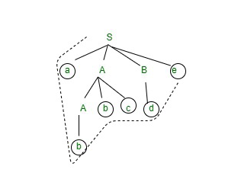
Let’s consider a simple grammar:
S -> aABe
A -> Abc | b
B -> d
Input: abbcde$
Steps:
Start with S -> aABe.
Generate a at the beginning and e at the end.
Expand A -> Abc and B -> d.
Now we have aAbcde.
Expand A -> b.
Final string: abbcde

Slide 36
Classification of Top-Down Parsing
With Backtracking: Brute Force Technique
2. Without Backtracking:
Recursive Descent Parsing
Predictive Parsing or Non-Recursive Parsing or LL(1) Parsing or Table Driver Parsing.

Slide 37
Backtracking is a search algorithm that explores all possible solutions to a problem by incrementally building a solution and undoing (backtracking) when it reaches an invalid state.
It is often used for problems where:
The solution space is large and exponential.
There are constraints that need to be satisfied.
We need to find all solutions or the best solution.
Backtracking is a brute force technique because it systematically explores all possibilities.

Slide 38
How Backtracking Works:
The basic idea is to:
Start with an empty solution.
Extend the solution incrementally by adding elements (choices).
If the current partial solution violates constraints, backtrack and try a different choice.
Repeat until a valid solution is found or all choices are exhausted.
Backtracking often involves recursion.

Slide 39
Examples of Backtracking Problems:
N-Queens Problem:
Place N queens on an NxN chessboard such that no two queens threaten each other.
Backtrack to explore all possible placements.
Sudoku Solver:
Fill a 9x9 grid with digits from 1 to 9, subject to certain rules.
Backtrack to find a valid solution.
Subset Sum Problem:
Given a set of integers, find a subset whose sum equals a given target.
Backtrack to explore all subsets.
Graph Coloring:
Assign colors to vertices of a graph such that no adjacent vertices have the same color.
Backtrack to find a valid coloring.

Slide 40
Pros and Cons of Backtracking:
Pros:
Guarantees finding all solutions (if needed).
Can handle complex constraints.
Simple to implement.
Cons:
Exponential time complexity (not efficient for large problem spaces).
Requires careful design to avoid unnecessary exploration.
May involve a lot of redundant work.

Slide 41
Brute Force Technique
The Brute Force Technique is a simple, comprehensive search strategy used in problem-solving.
It systematically explores every possible option until a problem’s answer is discovered.
Brute force is employed when the issue is small enough to allow an in-depth investigation.
However, due to its high temporal complexity, brute force techniques are inefficient for large-scale problems.

Slide 42
Pros and Cons of Brute Force Algorithm:
Pros:
Guaranteed Correctness: Brute force ensures finding the correct solution by listing all possible candidate solutions.
Generic Method: Not limited to any specific domain of problems.
Ideal for solving small and simpler problems.
Serves as a comparison benchmark for evaluating other design techniques.
Cons:
Inefficiency: Brute force approaches are inefficient. For real-time problems, the algorithm’s time complexity can exceed O(N!).
Lack of Algorithm Design: Relies more on compromising the power of a computer system rather than good algorithm design.
Slowness: Brute force algorithms are slow compared to more optimized approaches.
Lack of Creativity: Not as constructive or creative as other design paradigms.

Slide 43
Recursive Descent Parsing
Whenever a Non-terminal spends the first time then go with the first alternative and compare it with the given I/P String.
If matching doesn’t occur then go with the second alternative and compare it with the given I/P String.
If matching is not found again then go with the alternative and so on.
Moreover, If matching occurs for at least one alternative, then the I/P string is parsed successfully.

Slide 44
Predictive Parsing
Predictive parsing is a top-down parsing without backtracking
Namely, according to the next token, there is only one production to choose at each derivation step
stmt → if expr then stmt else stmt
| while expr do stmt
| begin stmt_list end

Slide 45
LL(k) Parsing
Predictive parsing is also called LL(k) parsing
The first L stands for scanning the input from left to right
The second L stands for producing a leftmost derivation
The k stands for using k lookahead input symbol to choose alternative productions at each derivation step

Slide 46
1. Left Recursion
A production of grammar is said to have left recursion if the leftmost variable of its RHS is same as variable of its LHS.
A grammar containing a production having left recursion is called as Left Recursive Grammar.
S → Sa / ∈
If we have the left-recursive pair of productions
A → Aα / β
where β does not begin with an A.
A → βA’
A’ → αA’ / ∈

Slide 47
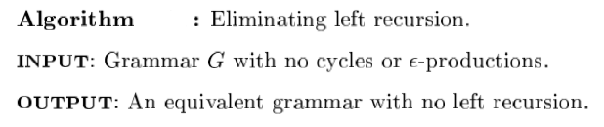

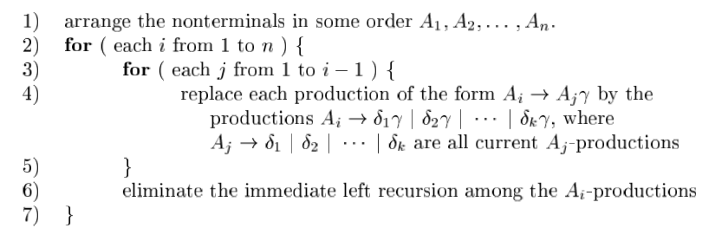

Slide 48
Consider the following grammar and eliminate left recursion-
E → E + T / T
T → T x F / F A → Aα / β
F → id A → βA’
A’ → αA’ / ∈
Solution
The grammar after eliminating left recursion is-
E → TE’
E’ → +TE’ / ∈
T → FT’
T’ → xFT’ / ∈
F → id

Slide 49
Consider the following grammar and eliminate left recursion-
S → (L) / a
L → L , S / S A → Aα / β A → βA’
A’ → αA’ / ∈
Solution-
The grammar after eliminating left recursion is-
S → (L) / a
L → SL’
L’ → ,SL’ / ∈

Slide 50


Left Factoring
Left factoring is a grammar transformation that is useful for producing a grammar suitable for predictive, or top-down, parsing.
When the choice between two alternative productions is not clear,
we may be able to rewrite the pro-ductions to defer the decision until enough of the input has been seen that we can make the right choice.

Slide 51
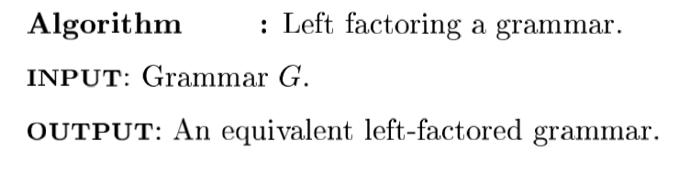
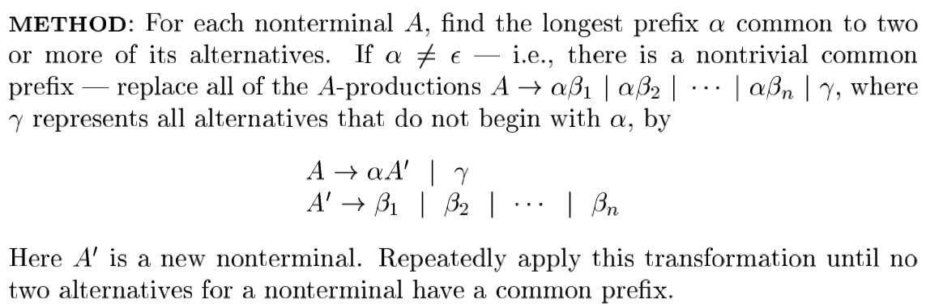

Slide 52
Do left factoring in the following grammar
S → iEtS / iEtSeS / a
E → b
The left factored grammar is
S → iEtSS’ / a
S’ → eS / ∈
E → b

Slide 53
First Function
Before calculating the first and follow functions, eliminate Left Recursion from the grammar, if present.
Rules For Calculating First Function-
Rule-01:
For a production rule X → ∈,
First(X) = { ∈ }
Rule-02:
For any terminal symbol ‘a’,
First(a) = { a }

Slide 54
Rule-03:
For a production rule X → Y₁Y₂Y₃,
Calculating First(X)
If ∈ ∉ First(Y₁), then First(X) = First(Y₁)
If ∈ ∈ First(Y₁), then First(X) = { First(Y₁) – ∈ } ∪ First(Y₂Y₃)
Calculating First(Y₂Y₃)
If ∈ ∉ First(Y₂), then First(Y₂Y₃) = First(Y₂)
If ∈ ∈ First(Y₂), then First(Y₂Y₃) = { First(Y₂) – ∈ } ∪ First(Y₃)
Similarly, we can make expansion for any production rule X → Y₁Y₂Y₃…..Y_{n}.

Slide 55
Rules For Calculating Follow Function-
Rule-01:
For the start symbol S, place $ in Follow(S).
Rule-02:
For any production rule A → αB,
Follow(B) = Follow(A)
Rule-03:
For any production rule A → αBβ,
If ∈ ∉ First(β), then Follow(B) = First(β)
If ∈ ∈ First(β), then Follow(B) = { First(β) – ∈ } ∪ Follow(A)

Slide 56
Calculate the first and follow functions for the given grammar-
S → aBDh
B → cC
C → bC / ∈
D → EF
E → g / ∈
F → f / ∈
First Functions
First(S) = { a }
First(B) = { c }
First(C) = { b , ∈ }
First(D) = { First(E) – ∈ } ∪ First(F) = { g , f , ∈ }
First(E) = { g , ∈ }
First(F) = { f , ∈ }

Slide 57
Calculate the first and follow functions for the given grammar-
S → aBDh
B → cC
C → bC / ∈
D → EF
E → g / ∈
F → f / ∈
Follow Functions
Follow(S) = { $ }
Follow(B) = { First(D) – ∈ } ∪ First(h) = { g , f , h }
Follow(C) = Follow(B) = { g , f , h }
Follow(D) = First(h) = { h }
Follow(E) = { First(F) – ∈ } ∪ Follow(D) = { f , h }
Follow(F) = Follow(D) = { h }

Slide 58
Calculate the first and follow functions for the given grammar-
S → (L) / a
L → SL’
L’ → ,SL’ / ∈
First Functions-
First(S) = { ( , a }
First(L) = First(S) = { ( , a }
First(L’) = { , , ∈ }
Follow Functions-
Follow(S) = { $ } ∪ { First(L’) – ∈ } ∪ Follow(L) ∪ Follow(L’) = { $ , , , ) }
Follow(L) = { ) }
Follow(L’) = Follow(L) = { ) }

Slide 59
Calculate the first and follow functions for the given grammar-
E → E + T / T
T → T x F / F
F → (E) / id
Solution
We have-,the given grammar is left recursive.
So, we first remove left recursion from the given grammar.
After eliminating left recursion, we get the following grammar-
E → TE’
E’ → + TE’ / ∈
T → FT’
T’ → x FT’ / ∈
F → (E) / id

Slide 60
First Functions-
First(E) = First(T) = First(F) = { ( , id }
First(E’) = { + , ∈ }
First(T) = First(F) = { ( , id }
First(T’) = { x , ∈ }
First(F) = { ( , id }
Follow Functions-
Follow(E) = { $ , ) }
Follow(E’) = Follow(E) = { $ , ) }
Follow(T) = { First(E’) – ∈ } ∪ Follow(E) ∪ Follow(E’) = { + , $ , ) }
Follow(T’) = Follow(T) = { + , $ , ) }
Follow(F) = { First(T’) – ∈ } ∪ Follow(T) ∪ Follow(T’) = { x , + , $ , ) }

Slide 61
Calculate the first and follow functions for the given grammar-
S → ACB / CbB / Ba
A → da / BC
B → g / ∈
C → h / ∈
First Functions-
First(S) = { First(A) – ∈ } ∪ { First(C) – ∈ } ∪ First(B) ∪ First(b) ∪ { First(B) – ∈ } ∪ First(S) = { d , g , h , ∈ , b , a }
First(A) = First(d) ∪ { First(B) – ∈ } ∪ First(C) = { d , g , h , ∈ }
First(B) = { g , ∈ }
First(C) = { h , ∈ }

Slide 62
Calculate the first and follow functions for the given grammar-
S → ACB / CbB / Ba
A → da / BC
B → g / ∈
C → h / ∈
Follow Functions-
Follow(S) = { $ }
Follow(A) = { First(C) – ∈ } ∪ { First(B) – ∈ } ∪ Follow(S) = { h , g , $ }
Follow(B) = Follow(S) ∪ First(a) ∪ { First(C) – ∈ } ∪ Follow(A) = { $ , a , h , g }
Follow(C) = { First(B) – ∈ } ∪ Follow(S) ∪ First(b) ∪ Follow(A) = { g , $ , b , h }

Slide 63
LL(1) Grammars
Predictive parsers, that is, recursive-descent parsers needing no backtracking,
can be constructed for a class of grammars called LL(1).
The first "L" in LL(1) stands for scanning the input from left to right,
The second "L" for producing a leftmost derivation,
and the " 1 " for using one input symbol of look ahead at each step to make parsing action decisions.

Slide 64
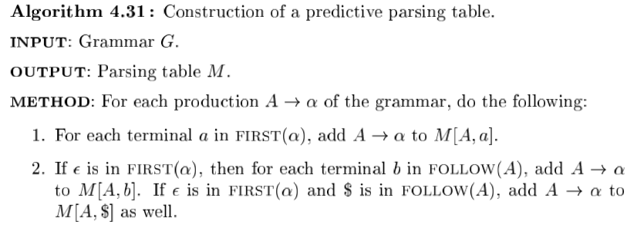

LL(1) Grammars

Slide 65
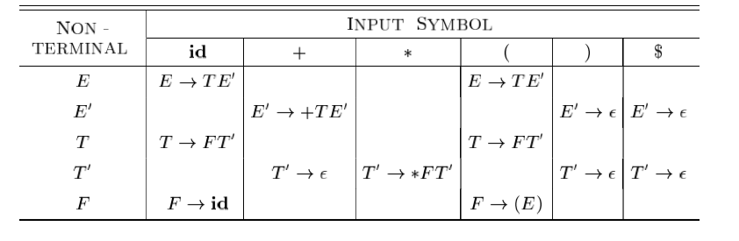
Construct LL(1) Table
E → E + T / T
T → T x F / F
F → (E) / id

Slide 66
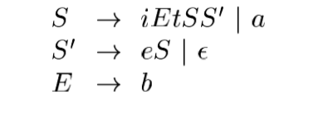
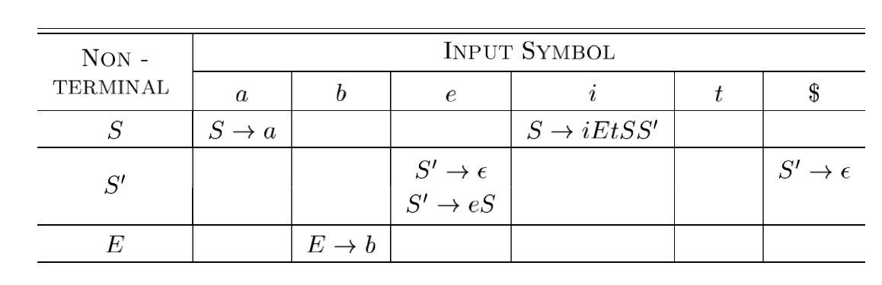
Construct LL(1) Table

Slide 67
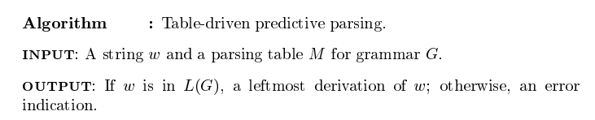
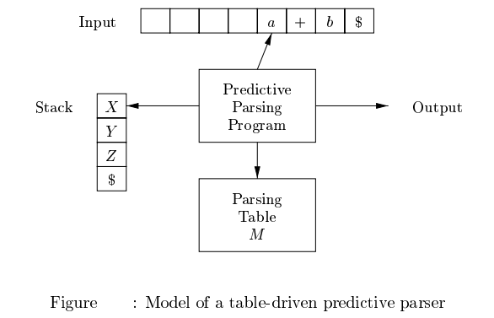
Non recursive Predictive Parsing
A non recursive predictive parser can be built by maintaining a stack explicitly,
rather than implicitly via recursive calls. The parser mimics a leftmost derivation.

Slide 68
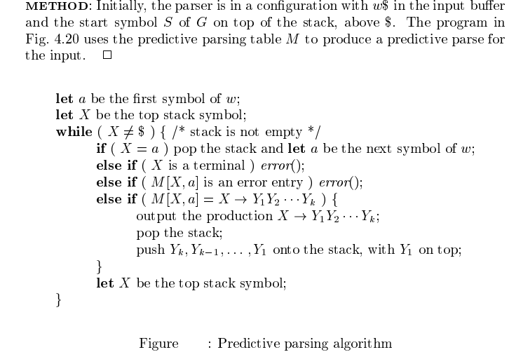

Slide 69
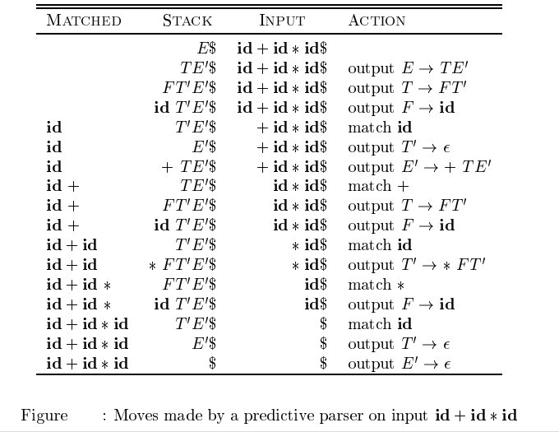

Slide 70
Error Recovery in Predictive Parsing
An error is detected during predictive parsing when the terminal on top of the stack does not match the next input symbol or
when nonterminal A is on top of the stack, a is the next input symbol, and
M[A, a] is error (the parsing-table entry is empty).
Panic-mode error recovery is based on the idea of skipping symbols on the the input until a token in a selected set of synchronizing tokens appears.
Its effectiveness depends on the choice of synchronizing set.
The sets should be chosen so that the parser recovers quickly from errors that are likely to occur in practice.

Slide 71
Place all symbols in FOLLOW(A) into the synchronizing set for nonterminal A.
2. Add keywords that begin statements to the synchronizing sets for the
Non terminals generating expressions.
3. Add symbols in FIRST(A) to the synchronizing set for nonterminal
4. If a nonterminal can generate the empty string, then the production deriving e
can be used as a default.
5. If a terminal on top of the stack cannot be matched, a simple idea is to
pop the terminal, issue a message saying that the terminal was inserted,
and continue parsing.

Slide 72
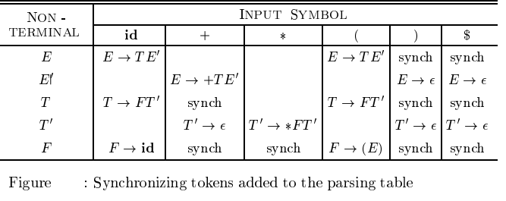
Phrase-level error recovery is implemented by filling in the blank entries in the predictive parsing table with pointers to error routines. These routines may change, insert, or delete symbols on the input and issue appropriate error messages. They may also pop from the stack.

Slide 73
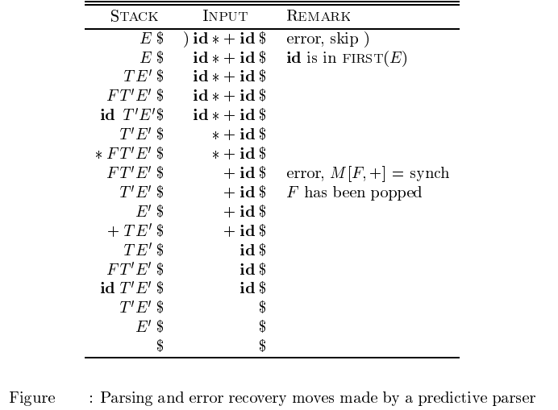

Slide 74
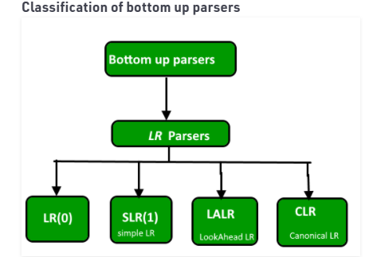
BOTTOM-UP PARSING
Constructing a parse tree for an input string beginning at the leaves and going towards the root is called bottom-up parsing. A general type of bottom-up parser is a shift-reduce parser.

Slide 75
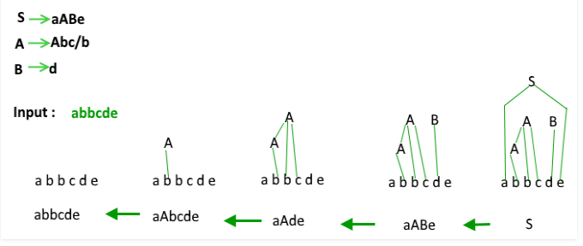

Slide 76

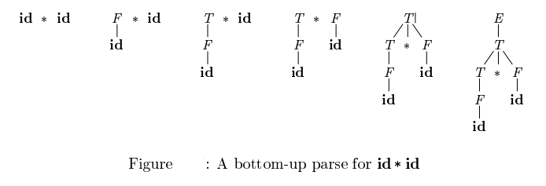

Slide 77
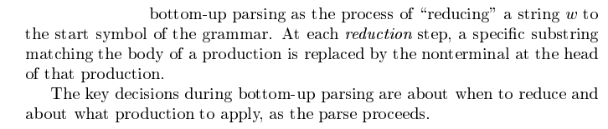
Reduction

Slide 78
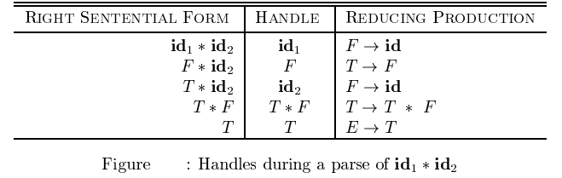
Handles
A handle of a string is a substring that matches the right side of a production,
and whose reduction to the non-terminal on the left side of the production
represents one step along the reverse of a rightmost derivation.
Consider the grammar

Slide 79

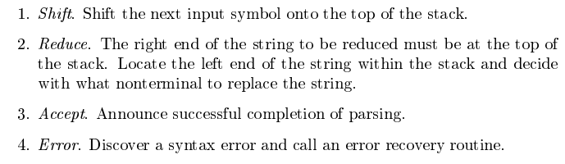
SHIFT-REDUCE PARSING
Shift-reduce parsing is a type of bottom-up parsing that attempts to construct a parse tree for an input string beginning at the leaves (the bottom) and working up towards the root (the top). Shift reduce parsing uses a stack to hold the grammar and an input tape to hold the string.

Slide 80
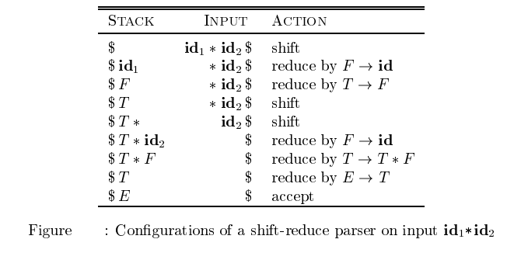

Slide 81
Conflicts in shift-reduce parsing
There are two conflicts that occur in shift-reduce parsing
1. Shift-reduce conflict: The parser cannot decide whether to shift or to reduce.
2. Reduce-reduce conflict: The parser cannot decide which of several reductions to make.

Slide 82
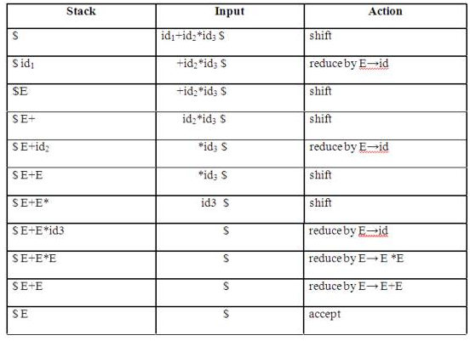
Stack implementation of shift-reduce parsing
E→E+E | E*E | id

Slide 83
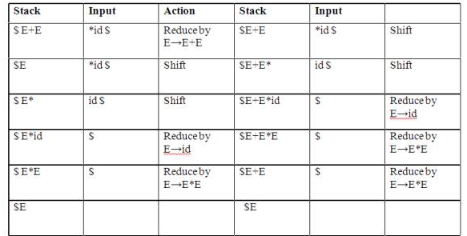
Shift-Reduce conflict
E→E+E | E*E | id

Slide 84
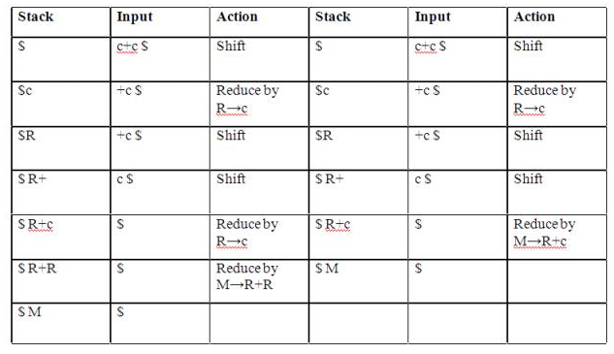
Reduce-Reduce conflict
M→R+R|R+c|R R→c

Slide 85
LR PARSERS
An efficient bottom-up syntax analysis technique that can be used CFG is called
LR(k) parsing.
The ‘L’ is for left-to-right scanning of the input, the ‘R’ for constructing a
rightmost derivation in reverse, and the ‘k’ for the number of input symbols.
When ‘k’ is omitted, it is assumed to be 1.
Drawbacks of LR method
It is too much of work to construct a LR parser by hand for a programming
language grammar.
A specialized tool, called a LR parser generator, is needed. Example: YACC.

Slide 86
Advantages of LR parsing:
1.It recognizes virtually all programming language constructs for which CFG
can be written.
2.It is an efficient non-backtracking shift-reduce parsing method.
3. A grammar that can be parsed using LR method is a proper superset of a
grammar that can be parsed with predictive parser.
4.It detects a syntactic error as soon as possible.

Slide 87
Augmented Grammar
If G is a grammar with start symbol S then G’, the augmented grammar for G, is the grammar with new start symbol S’ and a production S’ -> S. Let a grammar be
S -> AA A -> aA | b
The augmented grammar for the above grammar will be S’ -> S S -> AA A -> aA | b

Slide 88
LR(0) Items
An LR(0) is the item of a grammar G is a production of G with a dot at some position in the right side.
S -> ABC yields four items S -> .ABC S -> A.BC S -> AB.C S -> ABC.
The production A -> ε generates only one item A -> .ε

Slide 89
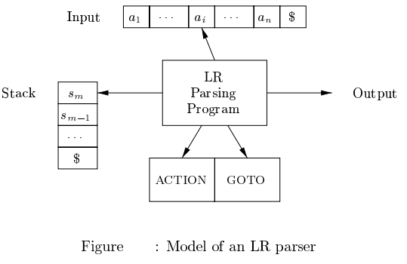

Slide 90
Closure Operation
If I is a set of items for a grammar G, then closure(I) is the set of items constructed from I by the two rules:
Initially every item in I is added to closure(I).
If A -> α.Bβ is in closure(I) and B -> γ is a production then add the item B -> .γ to I, If it is not already there. We apply this rule until no more items can be added to closure(I).

Slide 91
The Function GOTO
The second useful function is GOTO (I, X) where I is a set of items and X is a grammar symbol.
GOTO (I, X) is defined to be the closure of the set of all items [A -> aXb] such that [A -> a • Xb] is in I.
Intuitively, the GOTO function is used to define the transitions in the LR(0) automaton for a grammar.
The states of the automaton correspond to sets of items, and GOTO(I,X) specifies the transition from the state for I under input X.

Slide 92
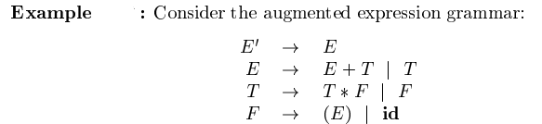
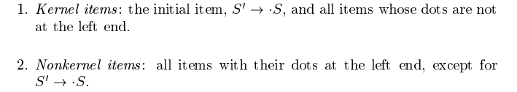

Slide 93
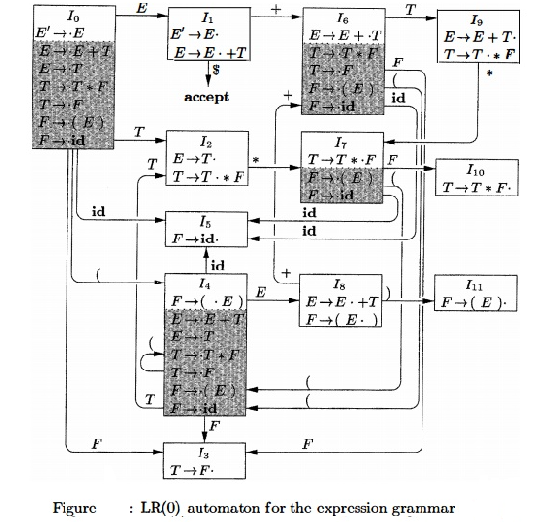

Slide 94
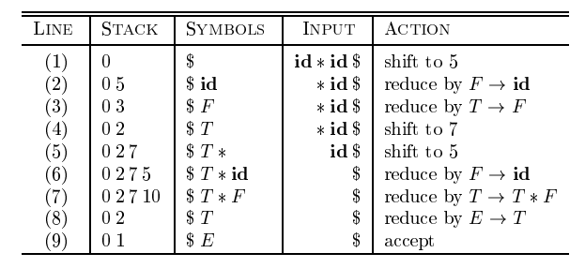

Slide 95
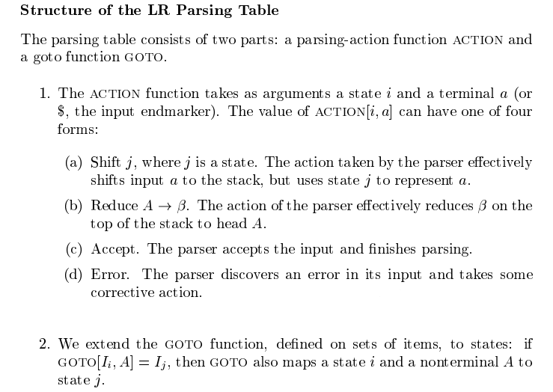

Slide 96

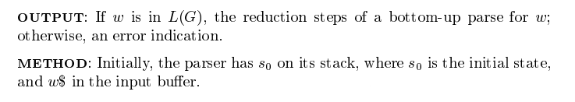
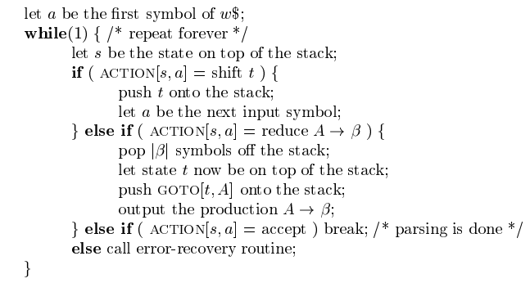

Slide 97
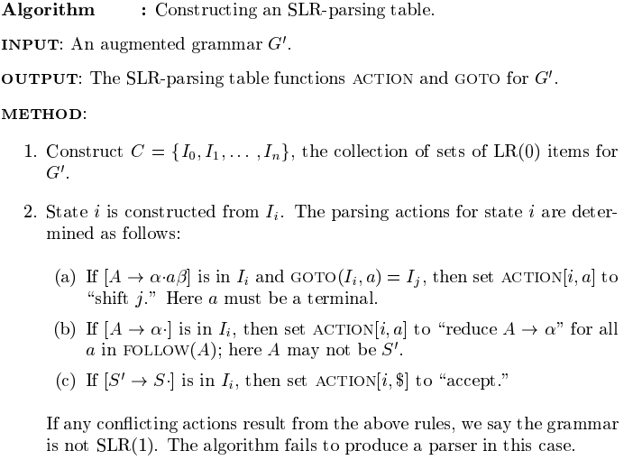
SLR parsing tables

Slide 98
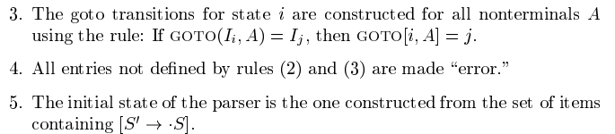

Slide 99
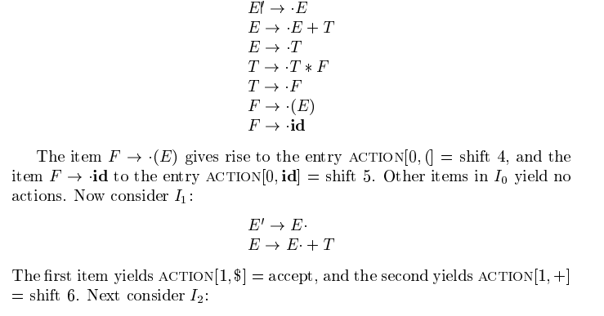
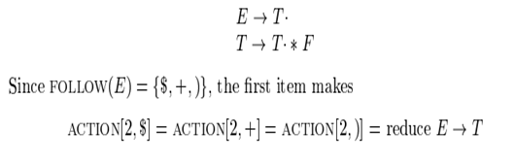

Slide 101
First Functions-
First(E) = First(T) = First(F) = { ( , id }
First(T) = First(F) = { ( , id }
First(F) = { ( , id }
Follow Functions-
Follow(E) = { $ ,+, ) }
Follow(T) = { + , $ , ) , * }
Follow(F) = { + , $ , ),* }

Slide 102

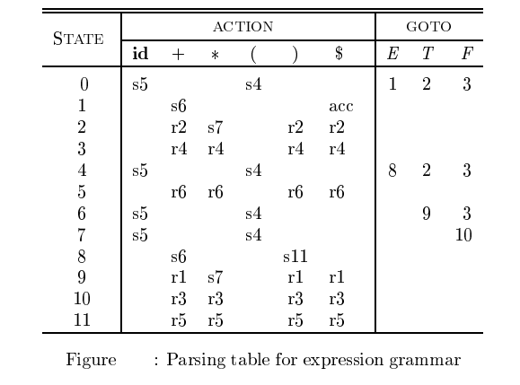

Slide 103
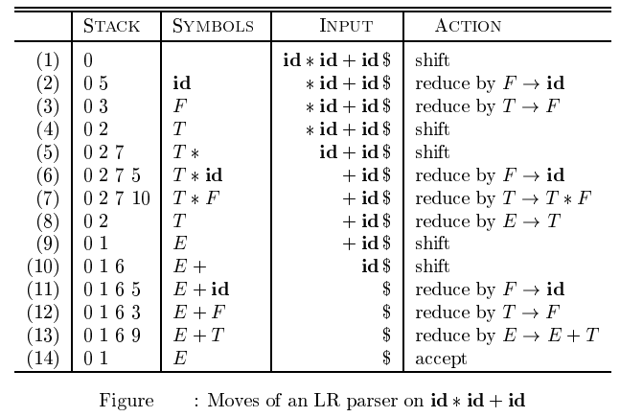

Slide 104
SLR ( 1 ) Grammar
S → E E → E + T | T T → T * F | F F → id
Add Augment Production and insert '•' symbol at the first position for every production in G
S` → •E E → •E + T E → •T T → •T * F T → •F F → •id

Slide 105
I0 State:
Add Augment production to the I0 State and Compute the Closure
I0 = Closure (S` → •E)
Add all productions starting with E in to I0 State because "." is followed by the non-terminal. So, the I0 State becomes
I0 = S` → •E E → •E + T E → •T
Add all productions starting with T and F in modified I0 State because "." is followed by the non-terminal. So, the I0 State becomes.

Slide 106
I0= S` → •E E → •E + T E → •T T → •T * F T → •F F → •id
I1= Go to (I0, E) = closure (S` → E•, E → E• + T)
I2= Go to (I0, T) = closure (E → T•, T →T. * F)
I3= Go to (I0, F) = Closure ( T → F• ) = T → F•
I4= Go to (I0, id) = closure ( F → id•) = F → id•

Slide 107
I5= Go to (I1, +) = Closure (E → E +•T)
Add all productions starting with T and F in I5 State because "." is followed by the non-terminal. So, the I5 State becomes
I5 = E → E +•T T → •T * F T → •F F → •id
Go to (I5, F) = Closure (T → F•) = (same as I3)
Go to (I5, id) = Closure (F → id•) = (same as I4)

Slide 108
I6= Go to (I2, *) = Closure (T → T * •F)
Add all productions starting with F in I6 State because "." is followed by the non-terminal. So, the I6 State becomes
I6 = T → T * •F F → •id
Go to (I6, id) = Closure (F → id•) = (same as I4)
I7= Go to (I5, T) = Closure (E → E + T•) = E → E + T•
I8= Go to (I6, F) = Closure (T → T * F•) = T → T * F•

Slide 109
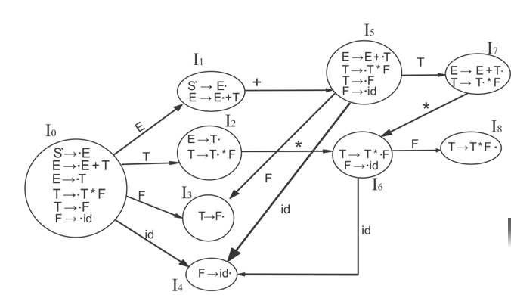

Slide 110
First (E) = First (E + T) ∪ First (T)
First (T) = First (T * F) ∪ First (F)
First (F) = {id}
First (T) = {id}
First (E) = {id}
Follow (E) = First (+T) ∪ {$} = {+, $}
Follow (T) = First (*F) ∪ First (F) = {*, +, $}
Follow (F) = {*, +, $}

Slide 111
I1 contains the final item which drives S → E• and follow (S) = {$}, so action {I1, $} = Accept
I2 contains the final item which drives E → T• and follow (E) = {+, $}, so action {I2, +} = R2, action {I2, $} = R2
I3 contains the final item which drives T → F• and follow (T) = {+, *, $}, so action {I3, +} = R4, action {I3, *} = R4, action {I3, $} = R4
I4 contains the final item which drives F → id• and follow (F) = {+, *, $}, so action {I4, +} = R5, action {I4, *} = R5, action {I4, $} = R5
I7 contains the final item which drives E → E + T• and follow (E) = {+, $}, so action {I7, +} = R1, action {I7, $} = R1
I8 contains the final item which drives T → T * F• and follow (T) = {+, *, $}, so action {I8, +} = R3, action {I8, *} = R3, action {I8, $} = R3.

Slide 112
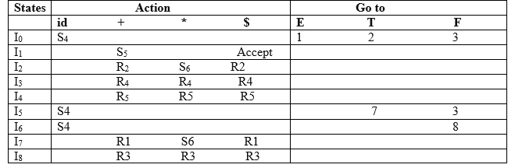

Slide 113
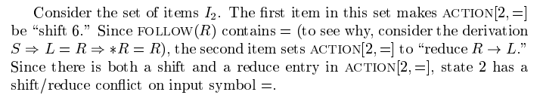
Every SLR(l) grammar is unambiguous, but there are many unambiguous grammars that are not SLR(l) . Consider the grammar with productions

Slide 114
The FIRST and FOLLOW sets are as follows
FIRST(S) = {*, id}
FIRST(L) = {*, id}
FIRST(R) = {*, id}
FOLLOW(S) = {$}
FOLLOW(L) = {$, =}
FOLLOW(R) = {$, =}
But, in reality, = can only follow L when L occurs in the context of production S → L = R, never when L is derived using production R → L.
So the shift reduce conflict in state 2 can be resolved by choosing the shift action without affecting any parses.

Slide 115
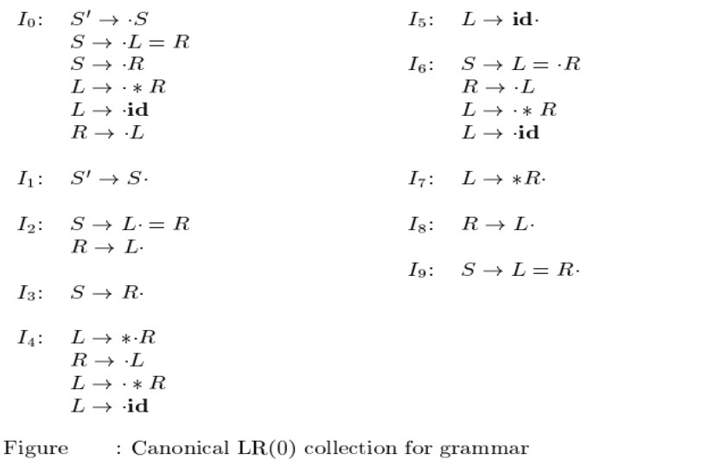

Slide 116
More Powerful LR Parsers
The "canonical-LR" or just "LR" method, which makes full use of the lookahead symbol(s). This method uses a large set of items, called the LR(1) items.
2. The "lookahead-LR" or "LALR" method, which is based on the LR(0) sets of
items, and has many fewer states than typical parsers based on the LR(1)
items.
3. By carefully introducing lookaheads into the LR(0) items,we can handle many
more grammars with the LALR method than with the SLR method, and build
parsing tables that are no bigger than the SLR tables.
4. LALR is the method of choice in most situations.

Slide 117
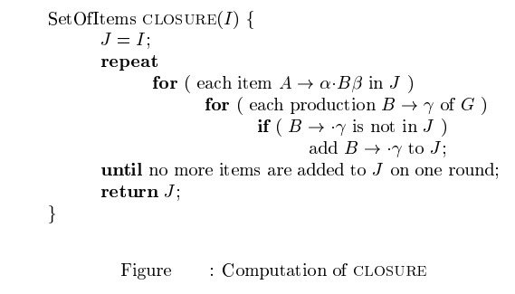
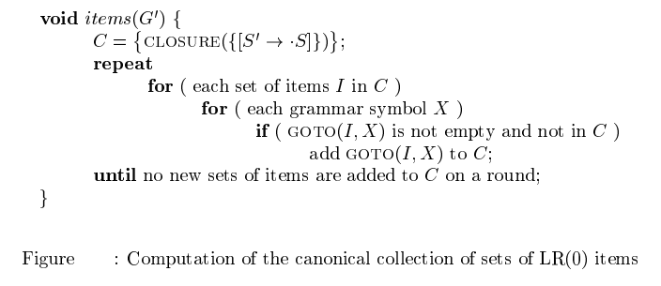
LR(0) Parsers

Slide 118
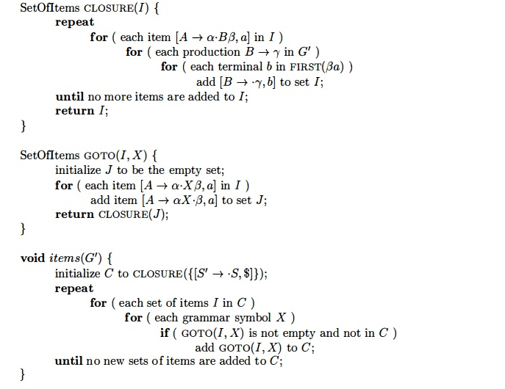

Slide 119
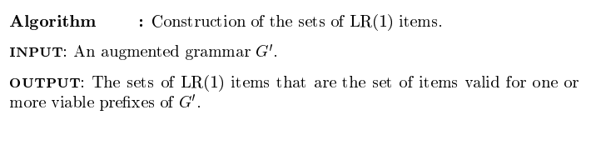

Slide 120

canonical LR(1) parsing tables

Slide 121

canonical LR(1) parsing tables

Slide 122




Slide 123



Slide 124



Slide 125



Slide 126


Slide 127


Slide 128



Slide 130



Slide 131


Slide 132
S.No | Top Down Parsing | Bottom Up Parsing
1. | It is a parsing strategy that first looks at the highest level of the parse tree and works down the parse tree by using the rules of grammar. | It is a parsing strategy that first looks at the lowest level of the parse tree and works up the parse tree by using the rules of grammar.
2. | Top-down parsing attempts to find the left most derivations for an input string. | Bottom-up parsing can be defined as an attempts to reduce the input string to start symbol of a grammar.
3. | In this parsing technique we start parsing from top (start symbol of parse tree) to down (the leaf node of parse tree) in top-down manner. | In this parsing technique we start parsing from bottom (leaf node of parse tree) to up (the start symbol of parse tree) in bottom-up manner.
4. | This parsing technique uses Left Most Derivation. | This parsing technique uses Right Most Derivation.
5. | It’s main decision is to select what production rule to use in order to construct the string. | It’s main decision is to select when to use a production rule to reduce the string to get the starting symbol.

Slide 133
LL | LR
Does a leftmost derivation. | Does a rightmost derivation in reverse.
Starts with the root nonterminal on the stack. | Ends with the root nonterminal on the stack.
Ends when the stack is empty. | Starts with an empty stack.
Uses the stack for designating what is still to be expected. | Uses the stack for designating what is already seen.
Builds the parse tree top-down. | Builds the parse tree bottom-up.
Continuously pops a nonterminal off the stack, and pushes the corresponding right hand side. | Tries to recognize a right hand side on the stack, pops it, and pushes the corresponding nonterminal.
Expands the non-terminals. | Reduces the non-terminals.
Reads the terminals when it pops one off the stack. | Reads the terminals while it pushes them on the stack.
Pre-order traversal of the parse tree. | Post-order traversal of the parse tree.

Slide 134
LR(0)⊂SLR(1)⊂LALR(1)⊂CLR(1)LR(0)⊂SLR(1)⊂LALR(1)⊂CLR(1)
If there is no RR conflict in CLR(1) then there may or may not be RR conflict in LALR(1)
If there is no SR conflict in CLR(1) then there is no SR conflicts in LALR(1)
Number of states in SLR(1) and LALR(1) are same, goto moves are identical ,shift moves are identical,
reduce moves may different else point 1 will never be satisfied.
LALR(1) and CLR(1) both uses LR(1) items.
LR(0) and SLR(1) both uses LR(0) items.

Slide 135


Slide 136
An Example
S → if E then S else S | begin L end | print E L → S ; L | ε
E → num = num
FIRST(S) = { if, begin, print } FIRST(L) = { if, begin, print , ε } FIRST(E) = { num }

Slide 137
Computing Follow Sets
Place $ in FOLLOW(S), where S is the start symbol and $ is the end-of-file marker
If there is a production A → α Bβ , then everything in FIRST(β) except for ε is placed in FOLLOW(B)
If there is a production A → α B or A → α Bβ where FIRST(β) contains ε , then everything in FOLLOW(A) is in FOLLOW(B)

Slide 138
An Example
S → if E then S else S | begin L end | print E L → S ; L | ε
E → num = num
FOLLOW(S) = { $, else, ; } FOLLOW(L) = { end }
FOLLOW(E) = { then, $, else, ; }

Slide 139
Table-Driven Predictive Parsing
Input. Grammar G. Output. Parsing Table M.
Method.
For each production A → α of the grammar, do steps 2 and 3.
For each terminal a in FIRST(α ), add A → α to M[A, a].
If ε is in FIRST(α ), add A → α to M[A, b] for each terminal b in FOLLOW(A). If ε is in FIRST(α ) and $ is in FOLLOW(A), add A → α to M[A, $].
Make each undefined entry of M be error.

Slide 140
An Example
 | S | L | E
if | S → if E then S else S S → begin L end S → print E | L → S ; L
then
else
begin |  | L → S ; L
end |  | L → ε
print |  | L → S ; L
num |  |  | E → num = num
;
$

Slide 141
An Example
Stack | Input
$ S | begin print num = num ; end $
$ end L begin | begin print num = num ; end $
$ end L | print num = num ; end $
$ end L ; S | print num = num ; end $
$ end L ; E print | print num = num ; end $
$ end L ; E | num = num ; end $
$ end L ; num = num | num = num ; end $
$ end L ; | ; end $
$ end L | end $
$ end | end $
$ | $

Slide 142
LL(1) Grammars
A grammar is LL(1) iff its predictive parsing table has no multiply-defined entries
A grammar G is LL(1) iff whenever A → α | β are two distinct productions of G, the following conditions hold:
FIRST(α) ∩ FIRST(β) = ∅,
If ε ∈FIRST(α), FOLLOW(A) ∩ FIRST(β) = ∅, (3)If ε ∈FIRST(β), FOLLOW(A) ∩ FIRST(α) = ∅.

Slide 143
A Counter Example
S → i E t S S' | a
S' → e S | ε
E → b
 | a | b | e | i | t | $
S | S → a |  |  | S → i E t S S'
S' |  |  | S' → ε S' → e S |  |  | S' → ε
E |  | E → b
ε ∈FIRST(ε) ∧ FOLLOW(S') ∩ FIRST(e S) = {e} ≠ ∅

Slide 144
Left Recursive Grammars
A grammar is left recursive if it has a nonterminal A such that A ⇒* A α
Left recursive grammars are not LL(1) because A → A α
A → β
will cause FIRST(A α) ∩ FIRST(β) ≠ ∅
We can transform them into LL(1) by eliminating left recursion

Slide 145
Eliminating Left Recursion
A → β R
R → α R | ε
A → A α | β
⇒
A
A
R
R
A
R
R
A
A
β
α α α
β
α α α
ε

Slide 146
Direct Left Recursion
A → A α₁ | A α₂ | ... | A α_{m} | β₁ | β₂ | ... | β_{n}
A → β₁ A' | β₂ A' | ... | β_{n} A'
A' → α₁ A' | α₂ A' | ... | α_{m} A' | ε

Slide 147
An Example
E → E + | T | T
T → T * | F | F
F → ( E | ) | id
E → T E' → + T → F | E' T T' | E' | | ε
T' → * | F | T' | ε
F → ( | E | ) | id

Slide 148
Indirect Left Recursion
S → A a | b
A → A c | S d | ε
S ⇒ A a ⇒ S d a
A → A c | A a d | b d | ε
S → A a | b
A → b d A' | A'
A' → c A' | a d A' | ε

Slide 149
Left factoring
A grammar is not LL(1) if two productions of a nonterminal A have a nontrivial common prefix. For example, if α ≠ ε , and A → α β₁ | α β₂, then FIRST(α β₁) ∩ FIRST(α β₂) ≠ ∅
We can transform them into LL(1) by performing left factoring
A → α A' A' → β₁ | β₂

Slide 150
An Example
S → i E t S | i E t S e S | a
E → b
S → i E t S S' | a
S' → e S | ε
E → b

Slide 151
Bottom-Up Parsing
Construct a parse tree from the leaves to the root using rightmost derivation in reverse
S → a A B e A → A b c | b B → d
input: abbcde
S
A B
A
A B
A
a b b c d e a b b c d e
⇐ aAde
A
A
A
a b b c d e
a b b c d e a b b c d e
⇐ aABe ⇐ S
abbcde ⇐ aAbcde

Slide 152
LR(k) Parsing
The L stands for scanning the input from left to right
The R stands for producing a rightmost derivation
The k stands for using k lookahead input symbol to choose alternative productions at each derivation step

Slide 153
An Example
S’ → S
S → if E then S else S
S → begin L end
S → print E
5. L → ε
L → S ; L
E → num = num

Slide 154
An Example
Stack | Input | Action
$ | begin print num = num ; end $ | shift
$ begin | print num = num ; end $ | shift
$ begin print | num = num ; end $ | shift
$ begin print num | = num ; end $ | shift
$ begin print num = | num ; end $ | shift
$ begin print num = num | ; end $ | reduce
$ begin print E | ; end $ | reduce
$ begin S | ; end $ | shift
$ begin S ; | end $ | reduce
$ begin S ; L | end $ | reduce
$ begin L | end $ | shift
$ begin L end | $ | reduce
$ S | $ | accept

Slide 155
LL(k) versus LR(k)
LL(k) parsing must predict which production to use after seeing only the first k tokens of the right-hand side
LR(k) parsing is able to postpone the decision until it has seen tokens corresponding to the entire right-hand side and k more tokens beyond
LR(k) parsing thus can handle more grammars than LL(k) parsing

Slide 156
LR Parsers
 |  |  |  |  |  | $
Input
s₂
Y
s₁
X
$
Parsing driver
Output
Parsing table
Finite Automaton
Stack

Slide 157
LR Parsing Tables
 | if | then | else | begin | end | print | ; | num | = | $ | S L E
1 | s3 |  |  | s4 |  | s5 |  |  |  |  | g2
2 | a
3 | s7 |  |  |  |  |  |  |  |  |  | g6
4 | s3 |  |  | s4 | r5 | s5 |  |  |  |  | g9 g8
5 | s7 |  |  |  |  |  |  |  |  |  | g10
6 | s11
7 | s12
8 | s13
9 | s14
10 |  | r4 | r4 |  |  |  | r4 | r4

Slide 158
LR Parsing Tables
 | if | then | else | begin | end | print | ; | num | = | $ | S L E
11 | s3 |  |  | s4 | s5 |  |  |  |  |  | g15
12 | s16
13 |  | r3 |  |  |  |  | r3 | r3
14 | r5 |  |  |  |  |  |  |  |  |  | g9 g17
15 | s18
16 |  | r7 | r7 |  |  |  | r7 | r7
17 | r6
18 | s3 |  |  | s4 | s5 |  |  |  |  |  | g19
19 |  |  | r2 |  |  |  | r2 | r2
action
goto

Slide 159
An Example
S’ → S
S → if E then S else S
S → begin L end
S → print E
5. L → ε
L → S ; L
E → num = num

Slide 160
An Example
Stack | Input | Action
$₁ $₁begin₄ $₁begin₄print₅ $₁begin₄print₅num₇ $₁begin₄print₅num₇=₁₂ $₁begin₄print₅num₇=₁₂num₁₆ $₁begin₄print₅E₁₀ $₁begin₄S₉ $₁begin₄S₉;₁₄ $₁begin₄S₉;₁₄L₁₇ $₁begin₄L₈ $₁begin₄L₈end₁₃ $₁S₂ | begin print num = num ; end $ print num = num ; end $ num = num ; end $ = num ; end $ num ; end $ ; end $ ; end $ ; end $ end $ end $ end $ $ $ | s4 s5 s7 s12 s16 r7 r4 s14 r5 r6 s13 r3 a

Slide 161
LR Parsing Driver
while (true) {
s = top(); a = gettoken();
if (action[s, a] == shift s’) { push(a); push(s’); } else if (action[s, a] == reduce A → α) {
pop 2 * | α | symbols off the stack;
s’ = goto[top(), A]; push(A); push(s’); } else if (action[s, a] == accept) { return; } else { error(); }
}

Slide 162



Bison – A Parser Generator
A langauge for specifying parsers and semantic analyzers
Bison compiler
lang.tab.c
lang.tab.h (-d option)
lang.y
C compiler
lang.tab.c
a.out
a.out
tokens
syntax tree

Slide 163

Bison Programs
%{
C declarations
%}
Bison declarations
%%
Grammar rules
%%
Additional C code

Slide 164

An Example
line → expr ‘\n’
expr → expr ‘+’ term | term term → term ‘*’ factor | factor factor → ‘(’ expr ‘)’ | DIGIT

Slide 165



An Example - expr.y
%%
line: expr ‘\n’
;
expr: expr ‘+’ term
| term
;
term: term ‘*’ factor
| factor
;
factor: ‘(’ expr ‘)’
| DIGIT
;
%token DIGIT
%start line

Slide 166



An Example - expr.y
%token NEWLINE
%token ADD
%token MUL
%token LP
%token RP
%token DIGIT
%start line
%%
line: expr NEWLINE
;
expr: expr ADD term
| term
;
term: term MUL factor
| factor
;
factor: LP expr RP
| DIGIT
;

Slide 167

An Example - expr.tab.h
#define NEWLINE 278
#define ADD 279
#define MUL 280
#define LP 281
#define RP 282
#define DIGIT 283

Slide 168
Semantic Actions
line: expr ‘\n’ {printf(“line: expr \\n\n”);}
; ^{Semantic action}
expr: expr ‘+’ term {printf(“expr: expr + term\n”);}
| ; | term | {printf(“expr: term\n”}
term: | term | ‘*’ factor {printf(“term: term * factor\n”;}
| | factor | {printf(“term: factor\n”);}
;
factor: ‘(’ expr ‘)’ {printf(“factor: ( expr )\n”);}
| DIGIT {printf(“factor: DIGIT\n”);}
;

Slide 169

Functions
yyparse(): the parser function
yylex(): the lexical analyzer function. Bison recognizes any non-positive value as indicating the end of the input

Slide 170

Variables
yylval: the attribute value of a token. Its default type is int, and can be declared to be multiple types in the first section using
%union {
int ival; double dval;
}
Tokens with attribute value can be declared as
%token <ival> intcon
%token <dval> doublecon

Slide 171

Conflict Resolutions
A reduce/reduce conflict is resolved by choosing the production listed first
A shift/reduce conflict is resolved in favor of shift
A mechanism for assigning precedences and assocoativities to terminals

Slide 172

Precedence and Associativity
The precedence and associativity of operators are declared simultaneously
%nonassoc ‘<’
%left ‘+’ ‘-’
%right ‘^’
/* lowest */
/* highest */
The precedence of a rule is determined by the precedence of its rightmost terminal
The precedence of a rule can be modified by adding %prec <terminal> to its right end

Slide 173
An Example
%{
#include <stdio.h>
%}
%token NUMBER
%left ‘+’ ‘-’
%left ‘*’ ‘/’
%right UMINUS
%%

Slide 174
An Example
line : expr ‘\n’
;
expr: expr ‘+’ expr
| expr ‘-’ expr
| expr ‘*’ expr
| expr ‘/’ expr
| ‘-’ expr %prec UMINUS
| ‘(’ expr ‘)’
| NUMBER
;

Slide 175

Error Report
The parser can report a syntax error by calling the user provided function yyerror(char *)
yyerror(char *s)
{
fprintf(stderr, “%s: line %d\n”, s, yylineno);
}

Slide 176
LR Parsing Table Generation
An LR parsing table generation algorithm transforms a CFG to an LR parsing table
SLR(1) parsing table generation
LR(1) parsing table generation
LALR(1) parsing table generation

Slide 177
From CFG to NPDA
An LR(0) item of a grammar in G is a production of G with a dot at some position of the right-hand side, A → α ∙ β
The production A → X Y Z yields the following four LR(0) items
A → • X Y Z, A → X Y • Z,
A → X • Y Z,
A → X Y Z •
An LR(0) item represents a state in a NPDA indicating how much of a production we have seen at a given point in the parsing process

Slide 178
An Example
1. E’ → E
2. E | → E + | T
3. E | → T
4. T | → T * | F
5. T | → F
6. F | → ( E | )
7. F | → id

Slide 179
An Example
2
9
15
18
E→•E+T
E
E→E•+T
+
E→E+•T
T
E→E+T•
_{ε} 4
_{ε} 5
ε
ε
10
6
13
17
20
ε
E→T•
F→•(E)
(
F→(•E)
E
F→(E•)
)
F→(E)•
T
ε
ε
_{ε} 2
_{ε} 3
1
3
5
7
14
E’→•E
ε
E→•T
ε
T→•F
F→•id
id
F→id•
F
12
ε
T→F•
ε
E
T→•T*F
T
T→T•*F
*
T→T*•F
16
F
T→T*F•
8
4
11
_{ε} 6
_{ε} 7
19
E’→E•
ε

Slide 180
From NPDA to DPDA
There are two functions performed on sets of LR(0) items (states)
The function closure(I) adds more items to I when there is a dot to the left of a nonterminal
The function goto(I, X) moves the dot past the symbol X in all items in I that contain X

Slide 181
The Closure Function
closure(I) = repeat
for any item A →α ∙ X β in I for any production X → γ
I = I ∪ { X → ∙ γ } until I does not change return I

Slide 182
An Example
1. E’ → E
s₁ = E’ → ∙ E,
I₁ = closure({s₁ }) = { E’ → ∙ E,
E → ∙ E + T,
2. E | → E + | T
3. E | → T
4. T | → T * | F
5. T | → F
6. F | → ( E | )
7. F | → id
E | → ∙ T,
T | → ∙ T * | F,
T | → ∙ F,
F | → ∙ ( E | ),
F | → ∙ id }

Slide 183
The Goto Function
goto(I, X) =
set J to the empty set
for any item A →α ∙ X β in I add A →α X ∙ β to J
return closure(J)

Slide 184
An Example
I₁ = {E’ → ∙ E,
E → ∙ E + T, E → ∙ T, T → ∙ T * F, T → ∙ F, F → ∙ ( E ), F → ∙ id }
goto(I₁ , E)
= closure({E’ → E ∙, E → E ∙ + T })
= {E’ → E ∙, E → E ∙ + T }

Slide 185
The Subset Construction Function
subset-construction(cfg) =
initialize T to {closure({S’ → ∙ S})} repeat
for each state I in T and each symbol X let J be goto(I, X)
if J is not empty and not in T then
T = T ∪ { J }
until T does not change return T

Slide 186
An Example
I₁ : {E’ → ∙ E, E → ∙ E + T, E → ∙ T, T → ∙ T * F, T → ∙ F, F → ∙ ( E ), F → ∙ id}
goto(I₁, E) = I₂ : {E’ → E ∙, E → E ∙ + T}
goto(I₁, T) = I₃ : {E → T ∙, T → T ∙ * F}
goto(I₁, F) = I₄ : {T → F ∙}
goto(I₁, ‘(’) = I₅ : {F → ( ∙ E ), E → ∙ E + T, E → ∙ T
T → ∙ T * F, T → ∙ F, F → ∙ ( E ), F → ∙ id} goto(I₁, id) = I₆ : {F → id ∙}
goto(I₂, ‘+’) = I₇ : {E → E + ∙ T, T → ∙ T * F, T → ∙ F F → ∙ ( E ), F → ∙ id}

Slide 187
An Example
goto(I₃, ‘*’) = I₈ : {T → T * ∙ F, F → ∙ ( E ), F → ∙ id}
goto(I₅, E) = I₉ : {F → ( E ∙), E → E ∙ + T}
goto(I₅, T) = I₃ goto(I₅, F) = I₄ goto(I₅, ‘(’) = I₅
goto(I₅, id) = I₆
goto(I₇, T) = I₁₀ : {E → E + T ∙, T → T ∙ * F}
goto(I₇, F) = I₄ goto(I₇, ‘(’) = I₅
goto(I₇, id) = I₆

Slide 188
An Example
goto(I₈, F) = I₁₁ : {T → T * F ∙} goto(I₈, ‘(‘) = I₅
goto(I₈, id) = I₆
goto(I₉, ‘)’) = I₁₂ : {F → ( E ) ∙} goto(I₉, ‘+’) = I₇
goto(I₁₀, ‘*’) = I₈

Slide 189
An Example
E’ → • E
E → • E + T
E → • T
T → • T * F
T → • F
F → • ( E )
F → • id 1
E F T
F → id •
F → ( • E ) E → • E + T E → • T
T → • T * F
T → • F
F → • ( E )
F → • id 5
id
id
F → ( E • ) E → E • + T | 9
 | +
( ) F → ( E ) • 12 1 10
6
(
E
T
8 id (
F
T → T * • F F → • ( E ) F → • id
3 *
F
T → T * F • 1
E → T •
T → T • * F _{id E → E + • T}
*
(
T → F •
T → • T * F
T → • F
F → • ( E ) F → • id
E → E + T •
T → T • * F
4
F
T
E’ → E •
E → E • + T
+
2
7

Slide 190
SLR(1) Parsing Table Generation
SLR(cfg) =
for each state I in subset-construction(cfg)
if A →α ∙ a β in I and goto(I, a) = J for a terminal a then action[I, a] = “shift J”
if A →α ∙ in I and A ≠ S’ then
action[I, a] = “reduce A →α” for all a in Follow(A) if S’ → S ∙ in I then action[I, $] = “accept”
if A →α ∙ X β in I and goto(I, X) = J for a nonterminal X then goto[I, X] = J
all other entries in action and goto are made error

Slide 191
An Example
 | + | * | ( ) | id | $ | E | T | F
1 |  |  | s5 | s6 |  | g2 | g3 | g4
2 | s7 |  |  |  | a
3 | r3 | s8 | r3 |  | r3
4 | r5 | r5 | r5 |  | r5
5 |  |  | s5 | s6 |  | g9 | g3 | g4
6 | r7 | r7 | r7 |  | r7
7 |  |  | s5 | s6 |  |  | g10 | g4
8 |  |  | s5 | s6 |  | g11
9 | s7 |  | s12
10 | r2 | s8 | r2 |  | r2

Slide 192
An Example
 | + | * | ( ) | id | $ | E | T | F
11 | r4 | r4 | r4 |  | r4
12 | r6 | r6 | r6 |  | r6

Slide 193
LR(I) Items
An LR(1) item of a grammar in G is a pair,
( A → α ∙ β, a ), of an LR(0) item A → α ∙ β and a lookahead symbol a
The lookahead has no effect in an LR(1) item of the form ( A → α ∙ β, a ), where β is not ε
An LR(1) item of the form ( A → α ∙ , a ) calls for a reduction by A → α only if the next input symbol is a

Slide 194
The Closure Function
closure(I) = repeat
for any item (A →α ∙ X β, a) in I for any production X → γ
for any b ∈ First(βa)
I = I ∪ { (X → ∙ γ, b) } until I does not change
return I

Slide 195
An Example
I₁ = closure({(S’ → ∙ S, $)}) =
S’ → S
S → C C
C → c C
C → d
{(S’ → ∙ S, $), (S → ∙ C C, $),
First($) = {$}
(C → ∙ c C, c), (C → ∙ c C, d),
(C → ∙ d, c), (C → ∙ d, d)}
First(C$) = {c, d}

Slide 196
The Goto Function
goto(I, X) =
set J to the empty set
for any item (A →α ∙ X β, a) in I add (A →α X ∙ β, a) to J
return closure(J)

Slide 197
An Example
goto(I₁, C)
= closure({S → C ∙ C, $)})
= {S → C ∙ C, $), (C → ∙ c C, $), (C → ∙ d, $)}

Slide 198
The Subset Construction Function
subset-construction(cfg) =
initialize T to {closure({(S’ → ∙ S , $)})} repeat
for each state I in T and each symbol X let J be goto(I, X)
if J is not empty and not in T then
T = T ∪ { J }
until T does not change return T

Slide 199
An Example
S’ → S
S → C C
C → c C
C → d

Slide 200
An Example
I₁: closure({(S’ → ∙ S, $)}) =
(S’ → ∙ S, $)
(S → ∙ C C, $) (C → ∙ c C, c/d) (C → ∙ d, c/d)
I₂: goto(I₁, S) = (S’ → S ∙, $) I₃: goto(I₁, C) =
(S → C ∙ C, $)
(C → ∙ c C, $)
(C → ∙ d, $)
I₄: goto(I₁, c) =
(C → c ∙ C, c/d) (C → ∙ c C, c/d) (C → ∙ d, c/d)
I₅: goto(I₁, d) = (C → d ∙, c/d)
I₆: goto(I₃, C) =
(S → C C ∙, $)

Slide 201
An Example
I₇: goto(I₃, c) =
(C → c ∙ C, $)
(C → ∙ c C, $)
(C → ∙ d, $)
I₈: goto(I₃, d) =
(C → d ∙, $)
I₉: goto(I₄, C) =
(C → c C ∙, c/d)
: goto(I₄, c) = I₄
: goto(I₄, d) = I₅ I₁₀: goto(I₇, C) =
(C → c C ∙, $)
: goto(I₇, c) = I₇
: goto(I₇, d) = I₈

Slide 202
LR(1) Parsing Table Generation
LR(cfg) =
for each state I in subset-construction(cfg)
if (A →α ∙ a β, b) in I and goto(I, a) = J for a terminal a then action[I, a] = “shift J”
if (A →α ∙, a) in I and A ≠ S’
then action[I, a] = “reduce A →α”
if (S’ → S ∙ , $) in I then action[I, $] = “accept”
if (A →α ∙ X β, a) in I and goto(I,X) = J for a nonterminal X then goto[I, X] = J
all other entries in action and goto are made error

Slide 203
An Example
 | c | d | $ | S | C
1 | s4 | s5 |  | g2 | g3
2 | a
3 | s7 | s8 |  | g6
4 | s4 | s5 |  | g9
5 | r4 | r4
6 | r2
7 | s7 | s8 |  | g10
8 | r4
9 | r3 | r3
10 | r3

Slide 204
An Example
$,r1
2
6
$,r2
C
c
S
C
c
3
7
C
10
$,r3
1
c
d d
c
4
8
$,r4
d
C
d
5
9
c/d,r3
c/d,r4

Slide 205
An Example
$,r1
2
6
$,r2
C
c
S
C
c
3
7
C
10
$,r3
1
c
d d
c
4
8
$,r4
d
C
d
5
9
c/d,r3
c/d,r4

Slide 206
The Core of LR(1) Items
The core of a set of LR(1) Items is the set of their first components (i.e., LR(0) items)
The core of the set of LR(1) items
{ (C → c ∙ C, c/d),
(C → ∙ c C, c/d),
(C → ∙ d, c/d) } is { C → c ∙ C,
C → ∙ c C, C → ∙ d }

Slide 207
Merging Cores
I₄: { (C → c ∙ C, c/d), (C → ∙ c C, c/d), (C → ∙ d, c/d) }
∪ I₇: { (C → c ∙ C, $), (C → ∙ c C, $), (C → ∙ d, $) }
⇒ I₄₇: { (C → c ∙ C, c/d/$), (C → ∙ c C, c/d/$),
(C → ∙ d, c/d/$) }
I₅: { (C → d ∙, c/d) } ∪ I₈: { (C → d ∙, $) }
⇒ I₅₈: { (C → d ∙, c/d/$) }
I₉: { (C → c C ∙, c/d) } ∪ I₁₀: { (C → c C ∙, $) }
⇒ I₉₁₀: { (C → c C ∙, c/d/$) }

Slide 208
LALR(1) Parsing Table Generation
LALR(cfg) =
for each state I in merge-core(subset-construction(cfg))
if (A →α ∙ a β, b) in I and goto(I, a) = J for a terminal a then action[I, a] = “shift J”
if (A →α ∙, a) in I and A ≠ S’
then action[I, a] = “reduce A →α”
if (S’ → S ∙, $) in I then action[I, $] = “accept”
if (A →α ∙ X β, a) in I and goto(I,X) = J for a nonterminal X then goto[I, X] = J
all other entries in action and goto are made error

Slide 209
An Example
 | c | d | $ | S | C
1 | s47 | s58 |  | g2 | g3
2 | a
3 | s47 | s58 |  | g6
47 | s47 | s58 |  | g910
58 | r4 | r4 | r4
6 | r2
910 | r3 | r3 | r3

Slide 210
Shift/Reduce Conflicts
stmt → if expr then stmt
| if expr then stmt else stmt
| other
Stack
$ - - - if expr then stmt
Input
else - - - $
Shift ⇒ if expr then stmt else stmt
Reduce ⇒ if expr then stmt

Slide 211
Reduce/Reduce Conflicts
stmt → id ( para_list ) | expr := expr para_list → para_list , para | para para → id
expr_list → expr_list , expr | expr expr → id ( expr_list ) | id
Stack
$ - - - id ( id
Input
, id ) - - - $
$- - - procid ( id
, id ) - - - $

Slide 212
LR Grammars
A grammar is SLR(1) iff its SLR(1) parsing table has no multiply-defined entries
A grammar is LR(1) iff its LR(1) parsing table has no multiply-defined entries
A grammar is LALR(1) iff its LALR(1) parsing table has no multiply-defined entries

Slide 213
Hierarchy of Grammar Classes
Unambiguous Grammars
LL(k) LR(k)
Ambiguous Grammars
LR(1)
LALR(1)
LL(1)
SLR(1)

